Slide 1
Probability Distributions and Sampling Techniques
Introduction to Statistics

Slide 2
Agenda
Random Variable
Discrete Random Variable
Continuous Random Variable
Probability Distribution
Cumulative Distribution Function
Discrete Probability Distribution
Uniform Distribution
Bernoulli Distribution
Binomial Distribution (Appendix)
Poisson Distribution

Slide 3
Agenda
Continuous Probability Distribution
Uniform Distribution (Appendix)
Normal Distribution
Population and Sample
Sampling Techniques
Probabilistic Sampling
Simple Random Sampling (with and without replacement)
Stratified Sampling
Systematic Sampling
Cluster Sampling

Slide 4
Agenda
Resampling
Bootstrap resampling
Jackknife resampling
Sampling Distribution
Parameter and Statistic
Sampling Distribution of Sample Mean
Sampling Distribution of Sample Proportion

Slide 5
Random Variable

Slide 6
Random variable
The action of rolling a die is called a random experiment
The set of possible outcomes of an experiment is called the Sample Space and it is denoted by Ω
Possible outcomes for this experiment are: 1, 2, 3, 4, 5, and 6
A Random Variable is a function defined from the sample space to real numbers

Slide 7
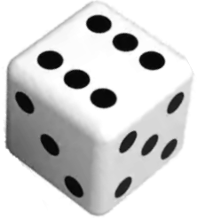
Random variable
The usual notation used for a random variable is ‘X’. However, other capital letters like U, V, or Z can be used
Let us observe the experiment of number appeared on the die. We define our random variable as
X: the number observed
X takes values 1, 2, 3, 4, 5, and 6.
Hence Ω = {1, 2, 3, 4, 5, 6}

Slide 8
Random variable
Question:
Suppose you are the owner of a grocery shop. You wish to improve the shopping experience of your customers, by easing their payment methods and ensuring that whichever products they demand are available in the shop.
Now collect the data for:
mode of payment
bill amount
Can you describe the nature of the data collected?

Slide 9
Random variable
Solution:
The nature of the data collected is as follows:
mode of payment: the data takes two distinct values Cashless payment and Cash payment
bill amount: It takes values such as $11.45, $32, $8.

Slide 10
Random variable
Random Variables
Discrete Variable
Continuous Variable
Eg: The mode of payment - cash, mobile wallet, card, bank transfer
Eg: The bill amount

Slide 11
Discrete random variable
A discrete random variable takes discrete values that is value from the set of whole numbers only or a set of categories
A discrete random variable can either take finite or countably infinite values
The possible outcomes can be listed effectively

Slide 12
Discrete random variable
Examples
Let V : The number of pages in a document Ω = {1, 2, 3,....}
Let X: The number of views for a youtube video Ω = {0, 1, 2, 3,... }
Let U: The size of the shirt available Ω = {XS, S, M, L, XL}
Note that random variables take values only from the set of whole numbers and are thus discrete random variables

Slide 13
Continuous random variable
A continuous random variable takes infinitely many values (within a specified range)
It can either take an uncountably infinite set of values or values in a given interval

Slide 14
Continuous random variable
Examples:
Let Z: The income of a person Ω = (0, maximum income of a person)
Let V: The level of water in a damn Ω = (0, height of the dam)
Note that random variables Z and V take values from a range and are thus continuous random variables

Slide 15
Identify whether the variable is discrete or continuous random variable.
1. Accidents on the New York highway
2. Fuel capacity of a car
3. Amount of milk in 15-ounce bottle
4. Members of the public health society
5. The total duration of a movie

Slide 16
Probability Distributions

Slide 17
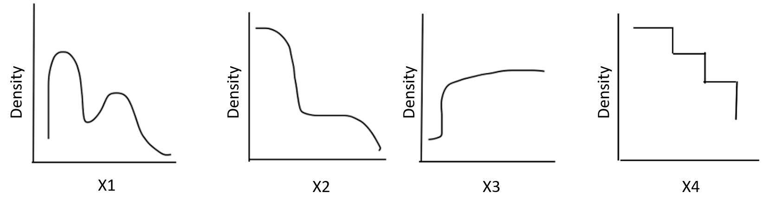
Distribution of the data
The distribution is a summary of the frequency of values taken by a random variable
The distribution of the data gives information on the shape and spread of the data
On plotting the histogram or a frequency curve for a variable, we actually look at how the data is distributed over its range

Slide 18
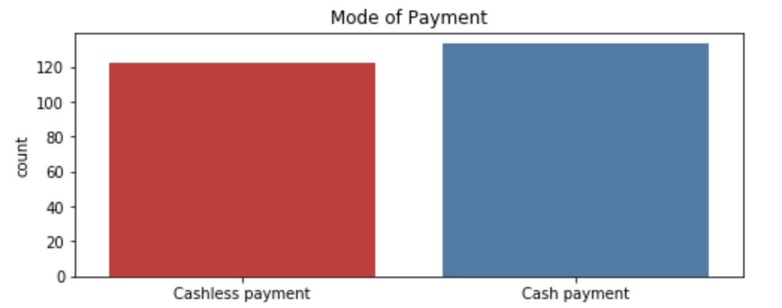
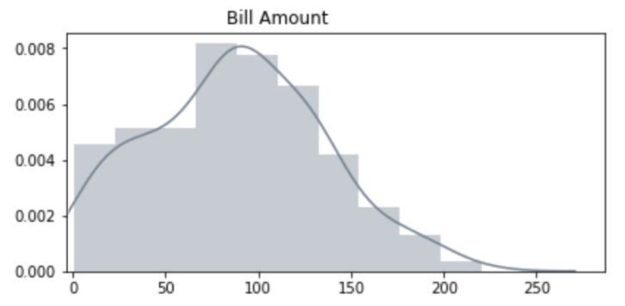
Probability distribution
Recall the example of data collection at the store. The data was collected for the mode of payment and the bill amount.
If we represent the data will have the following figures:

Slide 19
Need for probability distribution
The statistical tests have assumptions based on the probability distributions that are needed to be verified before using the test
Once the distribution of the data is known, the descriptive statistics of the data is readily available
For instance, if the stock trader can determine the probability distribution of a particular stock, then the trader can estimate the potential expected returns that may yield in the future

Slide 20
Probability distribution
A probability distribution is a list of all the possible outcomes of a random variable along with their corresponding probability of occurrence
P(X=x) refers to the probability that the random variable X takes a particular value x
A probability distribution is defined by its
probability mass function (p.m.f) for a discrete random variable
probability density function (p.d.f) for a continuous random variable

Slide 21
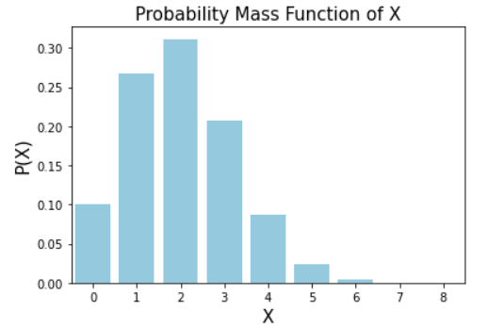
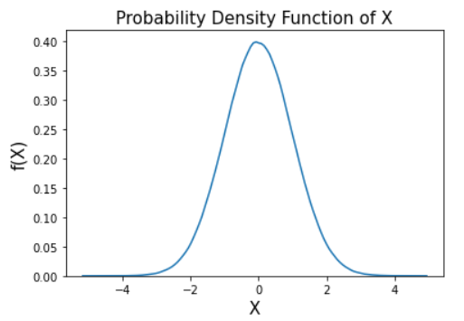
Probability distribution
Discrete Variable
Continuous Variable

Slide 22
The PMF and PDF difference
The mathematical difference between a discrete distribution and a continuous distribution is:
The discrete distribution is defined by the probability mass function (pmf) which is the probability at a particular point
The continuous distribution is defined by the probability density function (pdf) which is the integration over it’s range

Slide 23
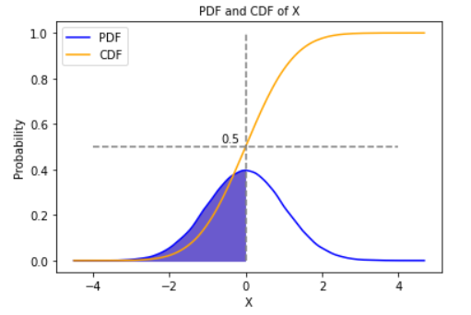
Cumulative distribution function (c.d.f.)
It gives the cumulative distribution function i.e P(X ≤ x)
Denoted by F(x)
That is, F(x) = P(X ≤ x)
The area of shaded region is 0.5

Slide 24
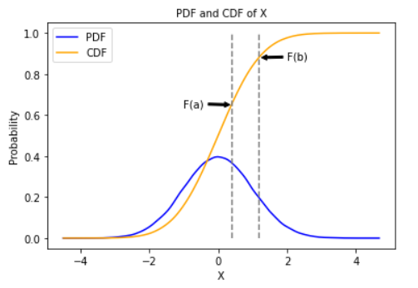
Properties of c.d.f.
0 ≤ F(x) ≤ 1 since it is a probability
An increasing function or monotonically non-decreasing function
F(-∞) = 0 and F(∞) = 1
For any two numbers a and b such that a < b, the probability is computed as: P(a ≤ X ≤ b) = F(b) - F(a)

Slide 25
Mathematical expectation of a random variable
It is the mathematical mean of a random variable
It is the central location
Also known as expected value
Denoted by µ
For a probability distribution, it is µ = ∑ x. f(x) Where f(x) is the probability mass function

Slide 26
Variance of a random variable
It is the mathematical mean of squares of deviations taken from the mean
Denoted by σ²
For a probability distribution, it is σ² = ∑ (x - µ)². f(x) where f(x) is the probability mass function

Slide 27
Probability distributions
Probability Distributions
Discrete Distributions
Continuous Distributions
Uniform
Bernoulli
Binomial
Poisson
Uniform
Normal

Slide 28

Probability distributions
Probability Distributions
Discrete Distributions
Continuous Distributions
Uniform
Bernoulli
Binomial
Poisson

Slide 29
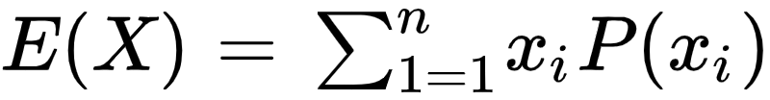
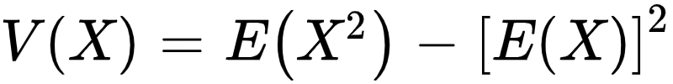
Discrete probability distribution
A discrete distribution comprises of the probabilities of the outcomes of a random variable with finite values and is used to model a discrete random variable
A discrete probability distribution is defined by its probability mass function (p.m.f)
The mathematical expectation E(X) and variance V(X) of a discrete probability distribution is given by
(Refer appendix A.1)

Slide 30
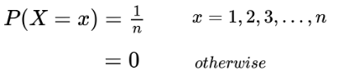
Uniform distribution (discrete)
A discrete random variable X follows a discrete uniform distribution if the p.m.f. is given as:
It is said X follows a uniform distribution with parameter n, i.e X~Uniform(n)
The values taken by X are equiprobable

Slide 31
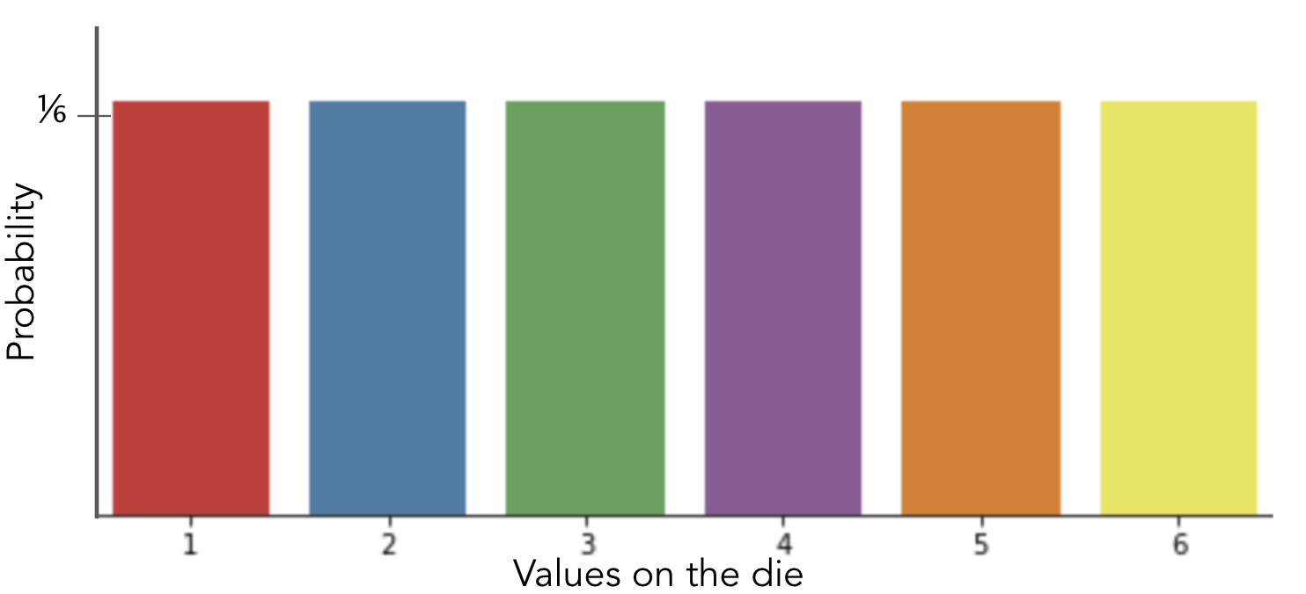
Uniform distribution (discrete)
Consider the experiment of rolling a fair die
All the outcomes are equally likely

Slide 32
Uniform distribution (discrete)
Examples:
The probability of it being Monday today
The probability of picking a random sample from the population of produced items

Slide 33
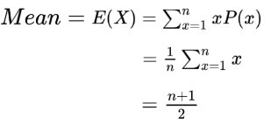
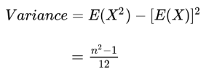
Uniform distribution (discrete)
The mean and the variance of the distribution is given as:
For our example, if n = 3 then E(X) = 2 and V(X) = ⅔.

Slide 34
Uniform distribution - python function
Python function | Description
randint.pmf() | returns the pmf of discrete uniform distribution

Slide 35
Uniform distribution
Question:
A factory has 6 machines numbered from 1 to 6. Let r.v. X be the machine number. What is the probability that a machine chosen at random is either 3 or 4?

Slide 36
Uniform distribution
Solution:
X: the machine number at is selected
To find: The probability that either machine 3 or 4 is chosen
The probability of any machine (1 to 6) to be chosen is ⅙
Thus the required probability is P(X = 3 or 4) = P(X = 3) + P(X = 4) = ⅙ + ⅙ = ⅓

Slide 37
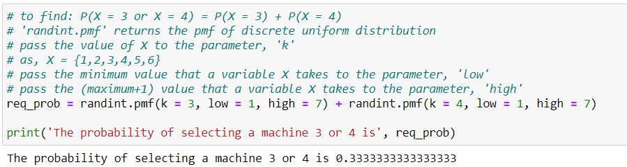
Uniform distribution
Python solution:

Slide 38
Bernoulli trial
An experiment which has exactly two possible outcomes is called a Bernoulli trial
Examples:
Tossing a coin (outcomes: Heads or Tails)
Germination of new seed (outcomes: Yes or No)
Gender of a newborn child (outcomes: Girl or Boy)

Slide 39
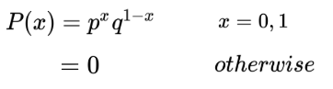
Bernoulli distribution
Based on the Bernoulli trial
A discrete random variable (X) follows a bernoulli distribution if the p.m.f. is given as:
p denotes the probability of success and q probability of failure
It is said as X follows Bernoulli distribution with parameter p, i.e X ~ Bernoulli(p)
This is the distribution of a random variable which takes only two values (denoted by failure = 0 and success = 1)

Slide 40
Bernoulli distribution
For the random variable X with only two outcomes such that the chance of both the outcomes is equal (i.e. p = ½), then X follows a discrete uniform distribution.

Slide 41
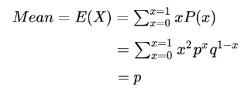
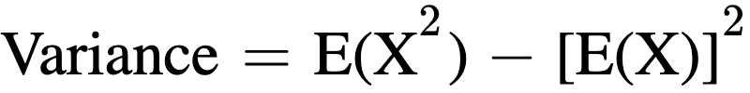
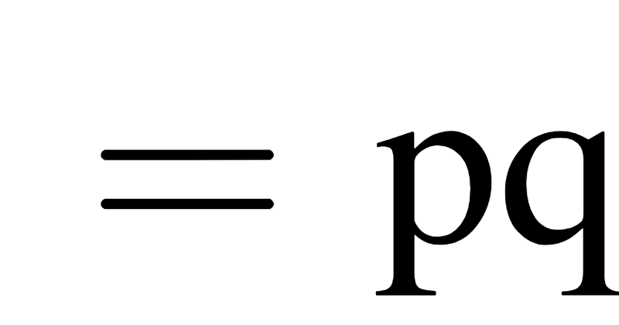
Bernoulli distribution
The mean and the variance of the distribution is given as:
For our example, if p = 0.2 and q = 0.8 Thus, E(X)= 0.2 and V(X) = 0.16

Slide 42
Bernoulli distribution - python function
Python function | Description
scipy.stats.bernoulli.pmf() | returns the pmf of discrete bernoulli distribution
scipy.stats.bernoulli.cdf() | returns the cdf of discrete bernoulli distribution

Slide 43
Bernoulli distribution
Question:
If 7 out of 10 times a soccer player scores a goal for a direct free kick. What would be the probability that he scores a goal for the next free-kick?

Slide 44
Bernoulli distribution
Solution:
The probability of whether he scores a goal for the next free kick can be calculated using bernoulli distribution,
Let X_{goal}⇒ X=1, X_{miss} ⇒ X=0
P(X=1)=0.7¹*0.3⁰ =0.7
Hence there is a 70% chance of player scoring a goal for the next free kick.

Slide 45
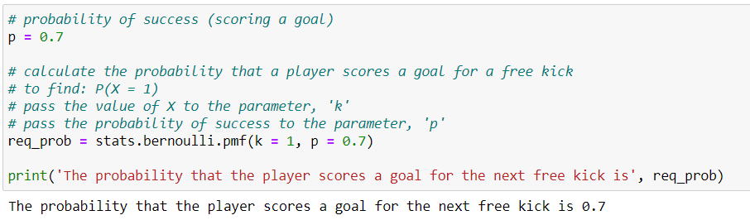
Bernoulli distribution
Python solution:

Slide 46
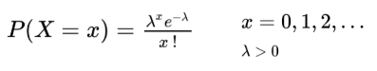
Poisson distribution
It is used to determine the probability of events that occur in a fixed interval of time/space
It is used to describe the distribution of rare events in a large population
A discrete random variable X follows a Poisson distribution with parameter λ, if p.m.f. of X is given as:
Where,
e = Euler’s number ( = 2.718)
x! = Factorial of x

Slide 47
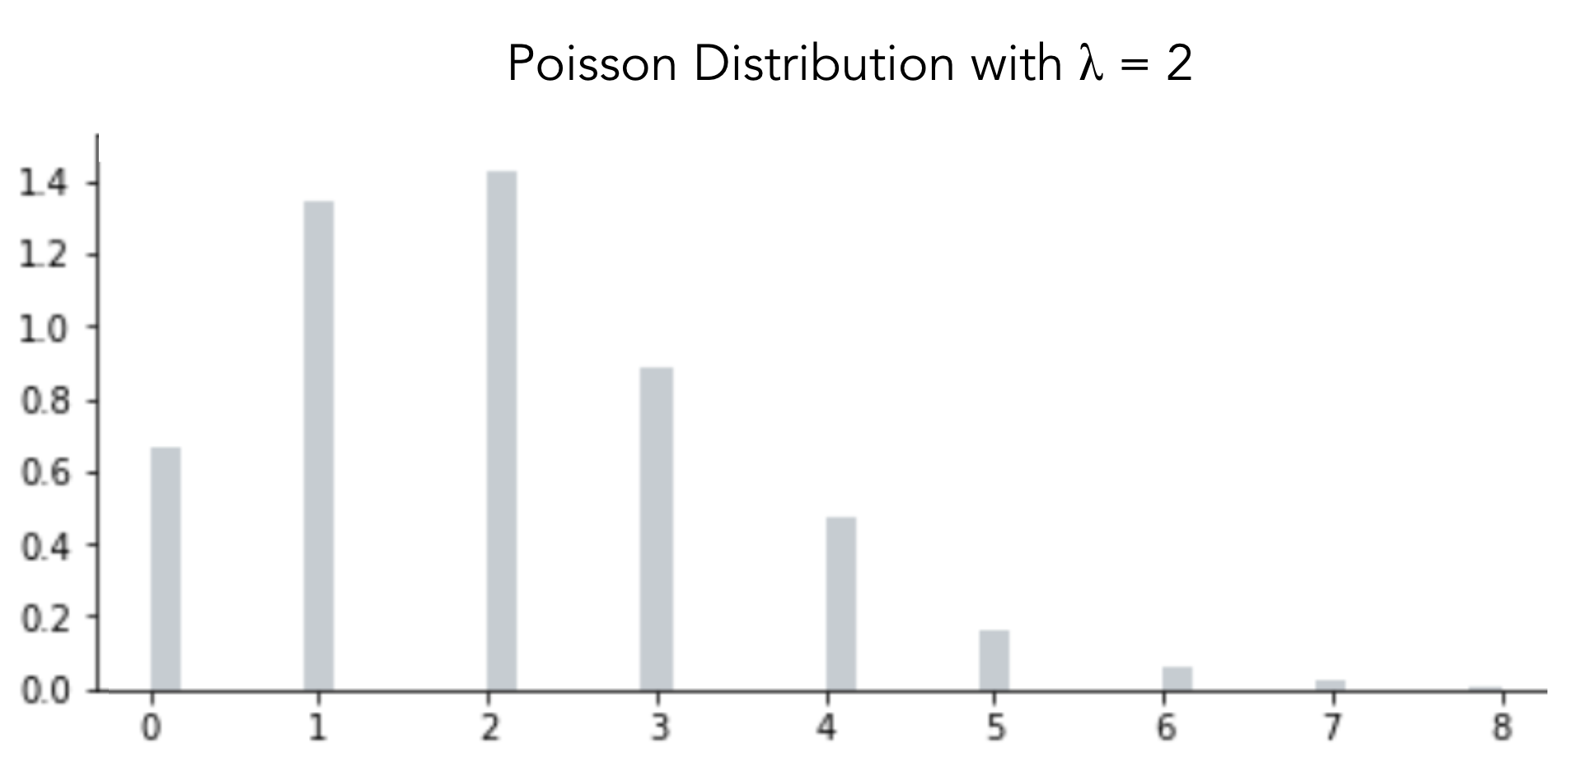
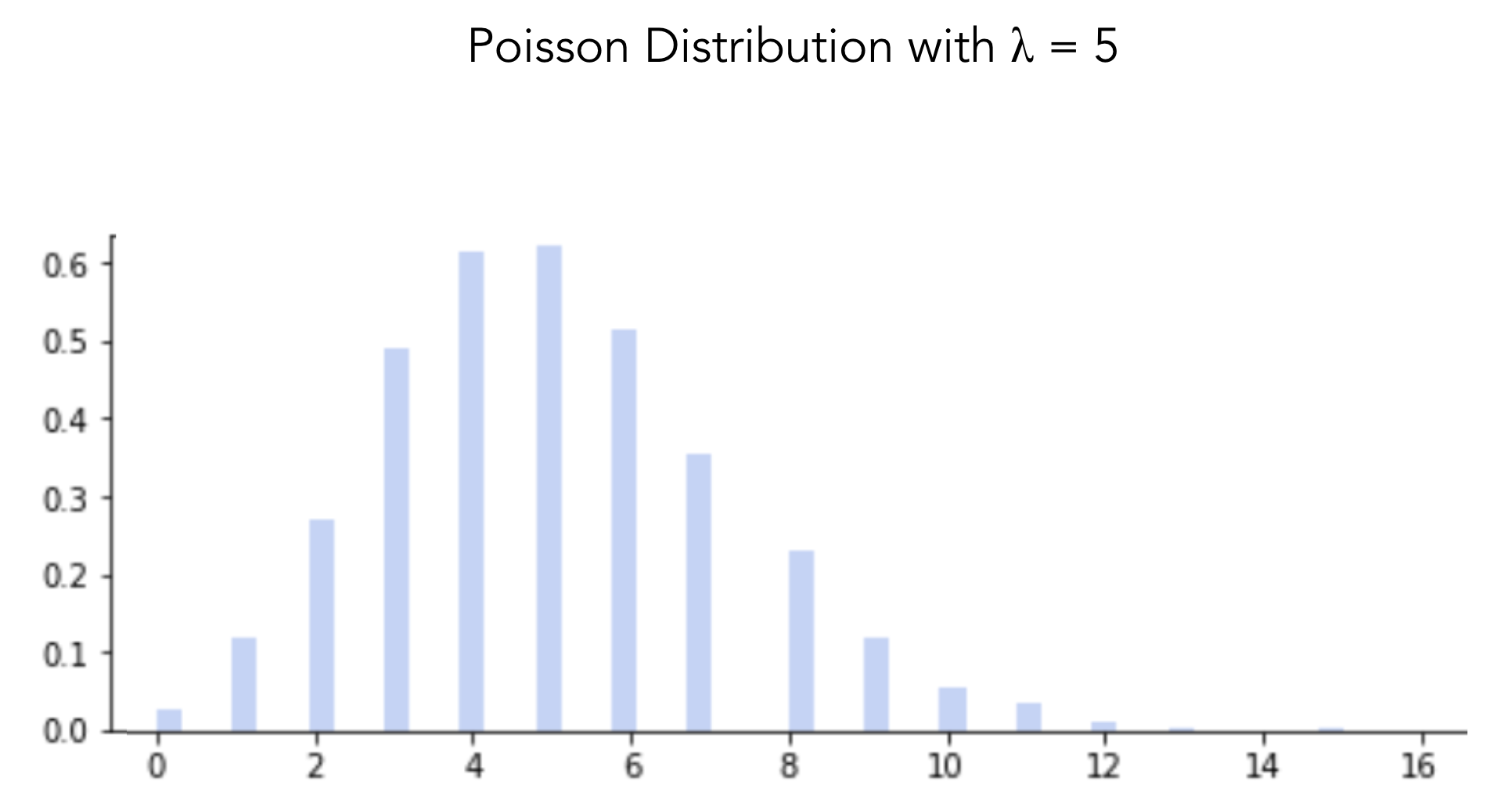
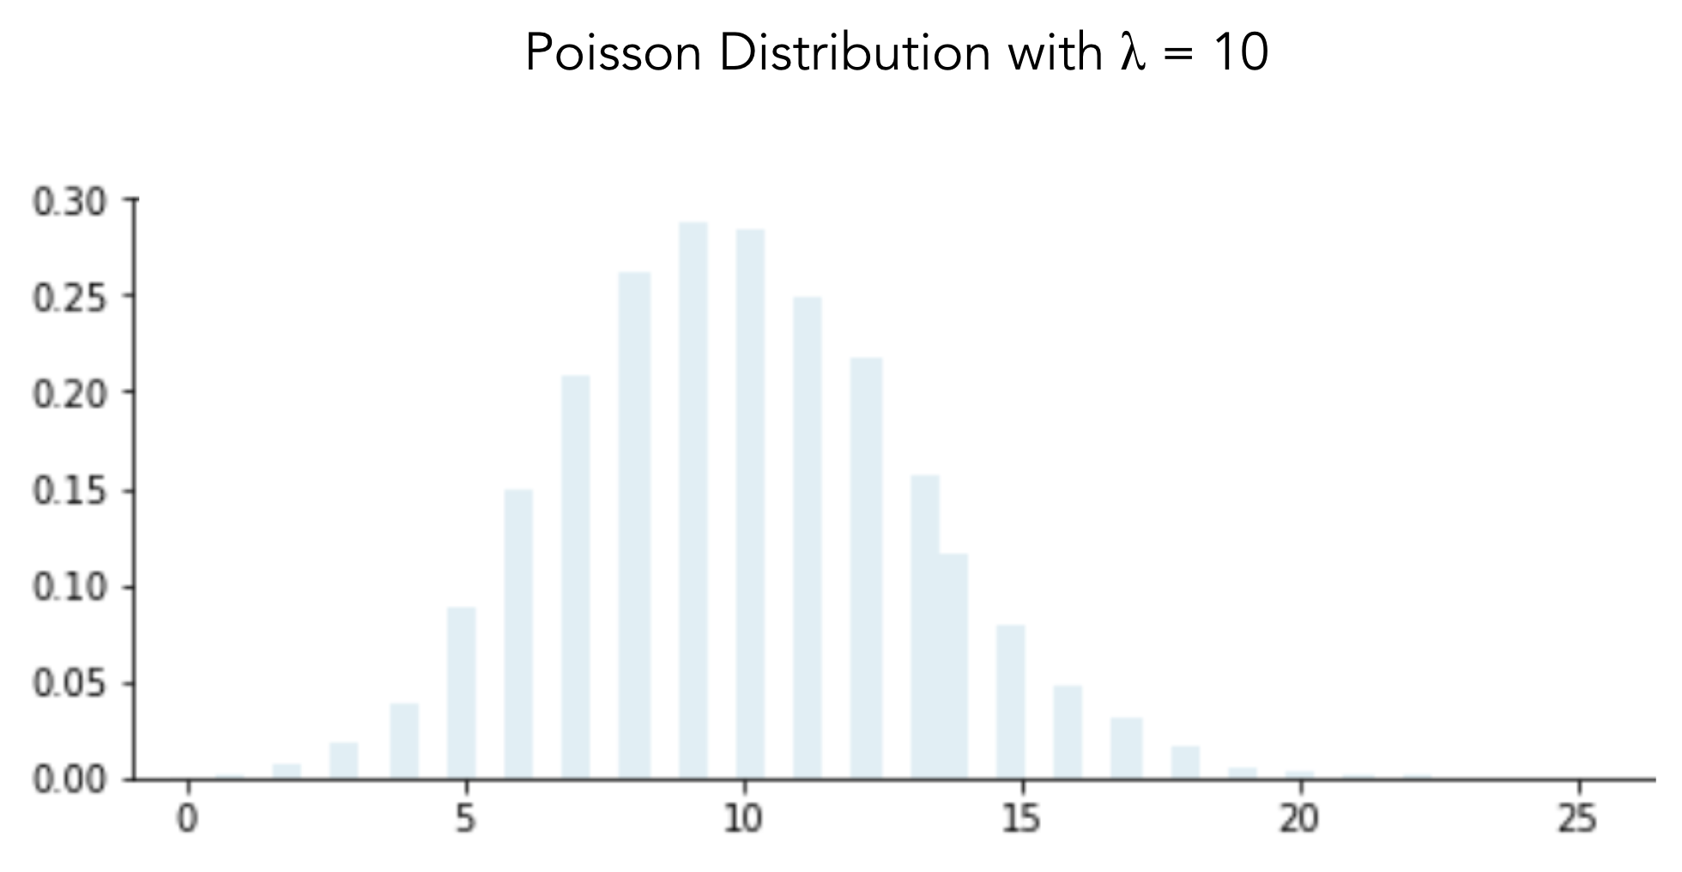
Poisson distribution
The Poisson distribution is positively skewed.

Slide 48
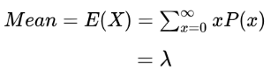
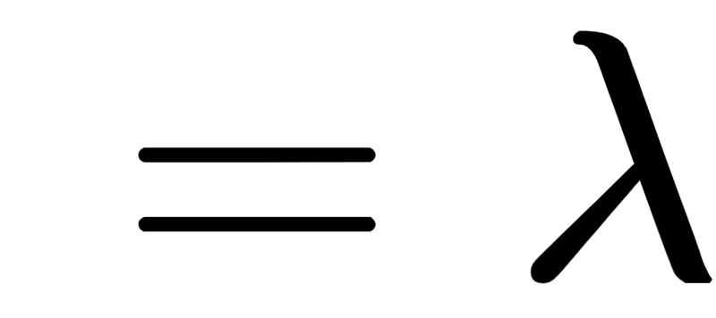
Poisson distribution
The mean and the variance of the distribution is given as:
Mean and variance of the poisson distribution are equal and it is the parameter of distribution.

Slide 49
Poisson as a limiting case of binomial distribution
Let X~Binomial(n, p) such that for large n (n ￫ ∞) and small p, np = m is a constant then X approaches Poisson(m)

Slide 50
Poisson distribution - python function
Python function | Description
scipy.stats.poisson.pmf() | returns the pmf of discrete poisson distribution
scipy.stats.poisson.cdf() | returns the cdf of discrete poisson distribution
scipy.stats.poisson.sf() | calculates the value of survival function (1 - cdf)

Slide 51
Poisson distribution
Question:
The number of calls received at a telephone exchange in a day follows a Poisson distribution. The probability that the telephone exchange receives 5 calls is three times the probability that the telephone exchange receives 10 calls. Obtain the average calls that the telephone exchange receives in a day.

Slide 52
Poisson distribution
Solution:
Let X: number of calls received at a telephone exchange
We know X~Poisson(λ)
It is known that probability the exchange receives 5 calls is three times that of the exchange receiving 10 calls. i.e. P(X=5) = 3 P(X=10)
To find: the average calls that the telephone exchange receives in a day

Slide 53
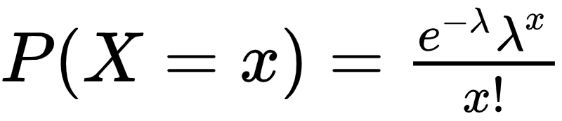
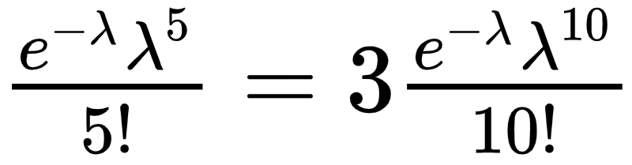
Poisson distribution
Solution:
The distribution of X is given by
We have,

Slide 54
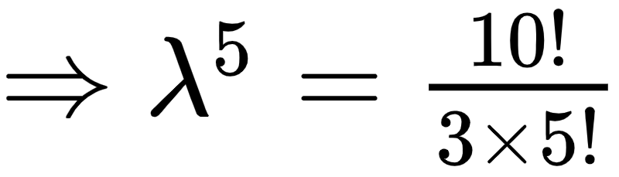
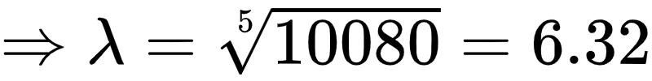
Poisson distribution
Solution:
Thus, the average calls received at the telephone exchange in a day are 6 (≈ 6.32)

Slide 55
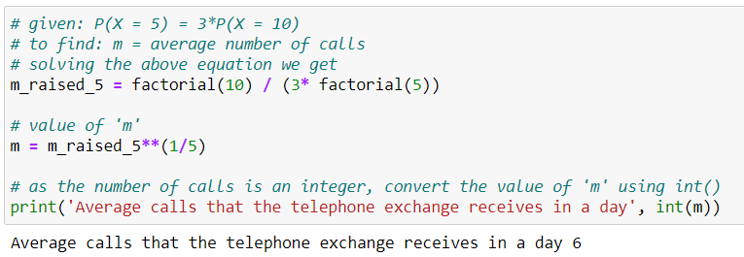
Poisson distribution
Python solution:

Slide 56
Summary
Some of the discrete distributions are: Uniform, Bernoulli, Binomial and Poisson
Discrete distribution is determined using probability mass function (p.m.f.)
In uniform distribution, all the values of the variable are equally likely
The sum of independent and identically distributed Bernoulli variables follows binomial distribution
Poisson distribution can be considered as a limiting case of a binomial distribution

Slide 57
Probability distributions
Probability Distributions
Discrete
Continuous
Uniform
Normal

Slide 58
Continuous probability distribution
It is a probability distribution of the continuous random variable
The continuous distributions are defined by their probability density function (p.d.f.) denoted as f(x)
The probability is given by the area under the pdf on a specified range. Thus, the value of the probability density function is 0 at a particular point
The area under the curve is always equal to 1. Therefore, is considered as a probability distribution

Slide 59
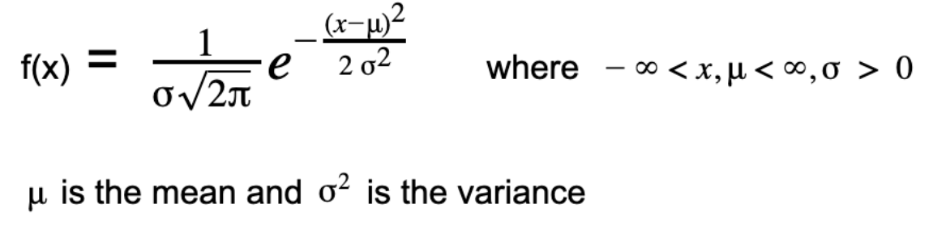
Normal distribution
The probability density function for the normal distribution is,
x and μ take value between -∞ to +∞
σ is strictly positive
It is said that X ~ N(𝛍, σ²), i.e the variable X follows the normal distribution with parameter 𝛍 and σ²

Slide 60
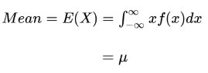
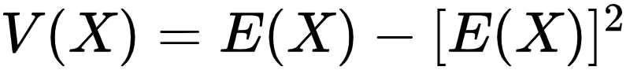
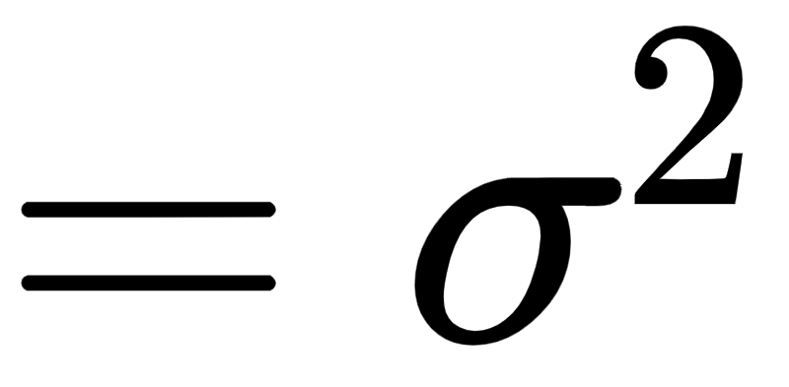
Normal distribution
The mean and the variance of the distribution is given as:

Slide 61
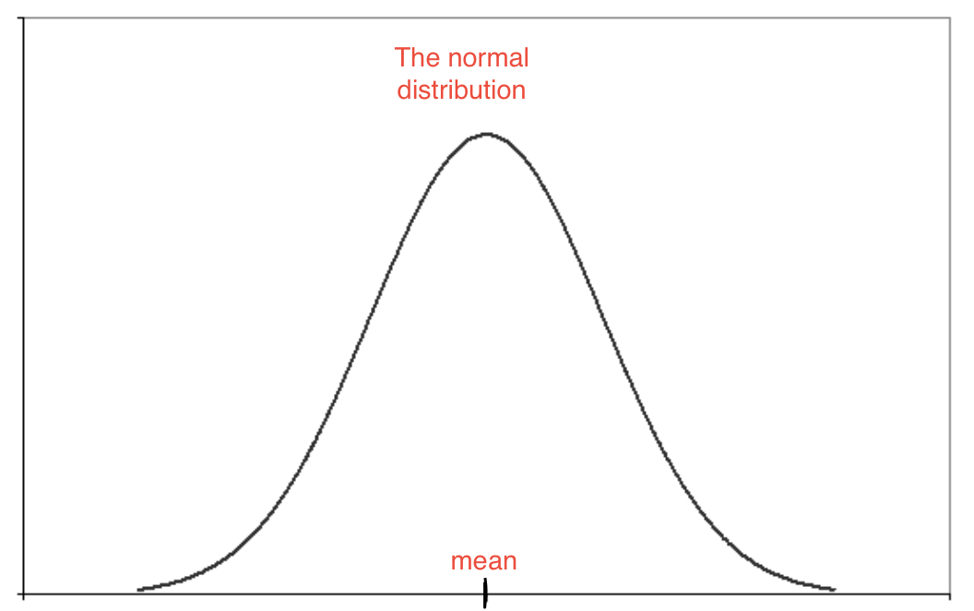
Normal distribution
Also called as the Gaussian distribution
The frequent observations are found in the middle of the distribution, and further decrease away towards the tails
A normal distribution has a bell-shaped density curve described by its mean and standard deviation
For normally distributed data,
Mean = Mode = Median
Symmetric about the center

Slide 62
Characteristics of normal distribution
The distribution is symmetric about the mean
For X ~ N(𝛍, σ²), P( X > a) = P ( X < -a) due to symmetricity
The standard normal distribution has mean 0 and variance 1
For X ~ N(𝛍, σ²), if Z = (x - 𝛍)/σ then Z ~ N(0, 1) that is the standard normal distribution

Slide 63
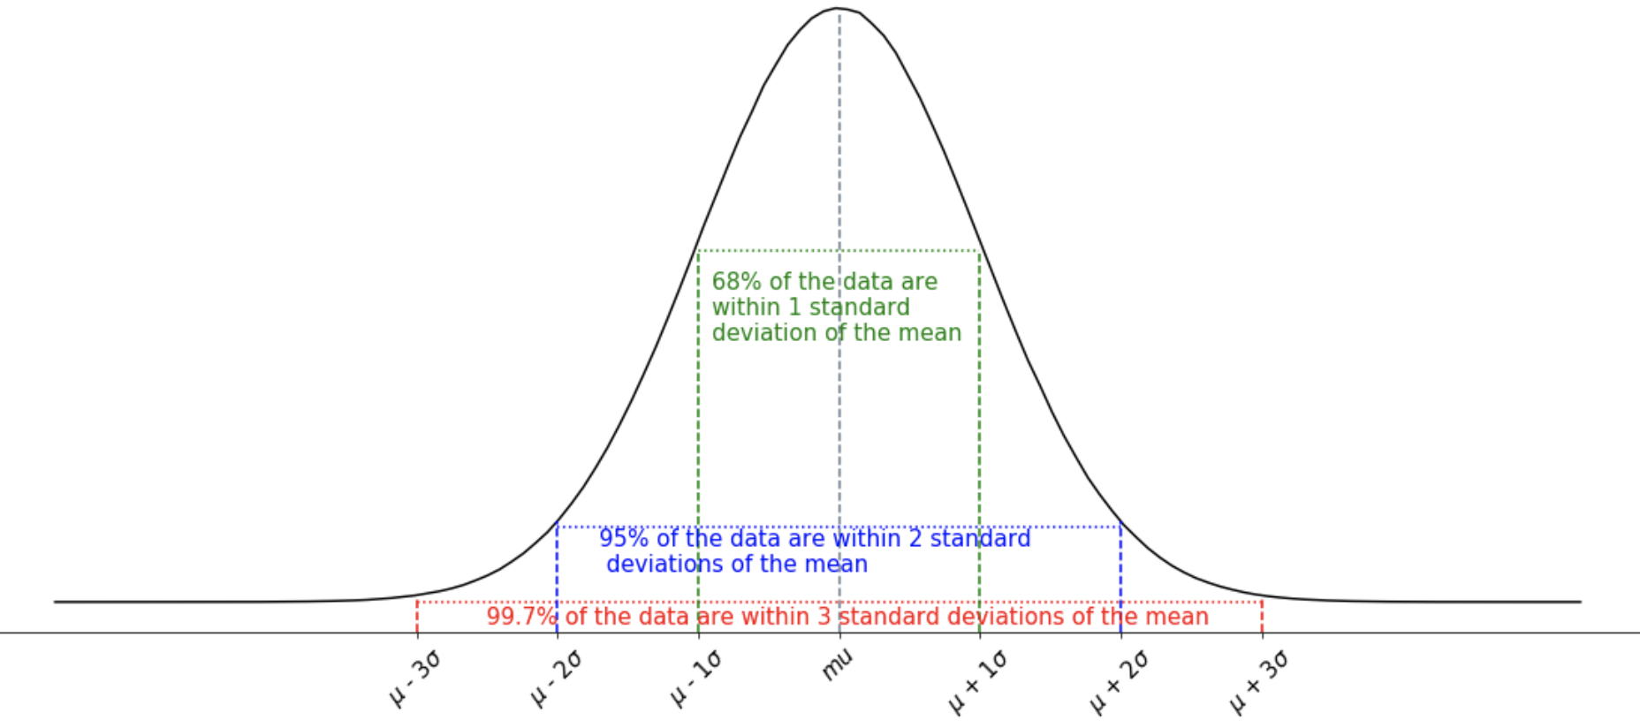
The normal distribution spread

Slide 64
Normal distribution
IQ of the human population is the example of normal distribution
Most of the people in the specific population have average IQ
The number of people with higher IQ and lower IQ than the average IQ is almost equal, and a very less number of people have extremely less IQ or extremely high IQ

Slide 65
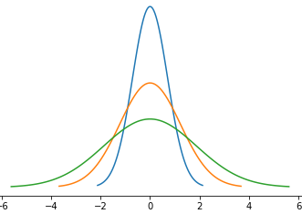
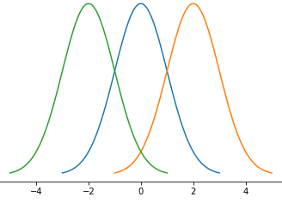
Different shapes of normal distribution
Normal distributions with same standard deviation but different means:
Normal distributions with same mean but different standard deviations:

Slide 66
Normal approximation of binomial distribution
Let X~Binomial(n, p) such that for large np ≥ 5 and n(1 - p) ≥ 5 then X approaches Normal distribution with mean µ = np and variance σ² = √np(1 -p)

Slide 67
Normal distribution - python function
Python function | Description
scipy.stats.normal.pmf() | returns the pmf of discrete normal distribution
scipy.stats.normal.cdf() | returns the cdf of discrete normal distribution
scipy.stats.normal.sf() | calculates the value of survival function (1 - cdf)

Slide 68
Normal distribution
Question:
A monthly balance in the bank account of credit card holders is assumed to be normally distributed with mean $500 and variance $100. What is the probability that the balance can be more than $513.5?

Slide 69
Normal distribution
Solution:
Let X: monthly balance in the bank account of a credit card holders
X ~ N(𝛍 = 500, σ² = 100)
To find: the probability that the balance can be more than $513.5
The required probability is P(X > 513.5)

Slide 70
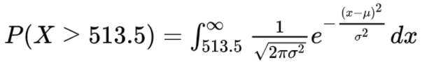
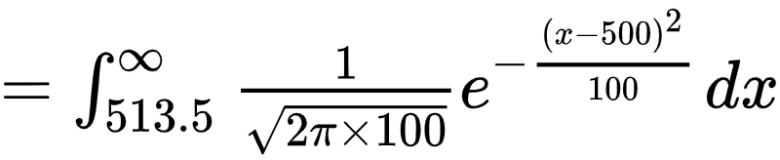
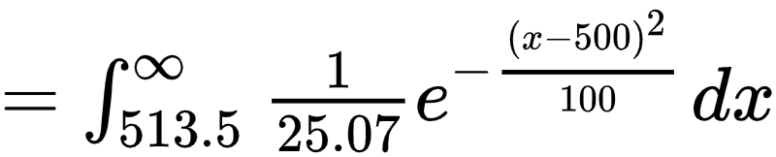
Normal distribution
Solution:
… Here is a problem. We see it is difficult to solve the integral, so we make use of the normal tables.

Slide 71
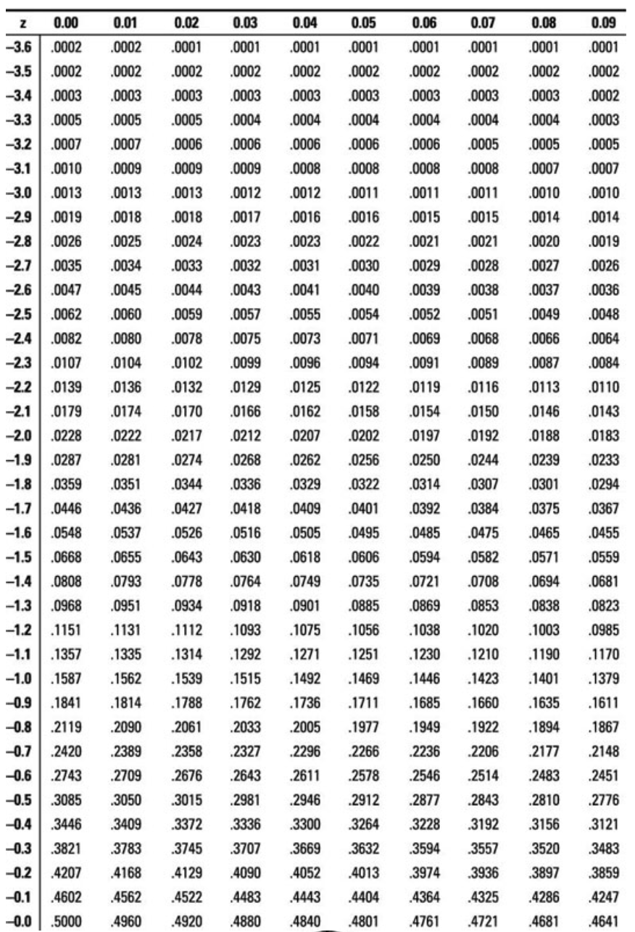
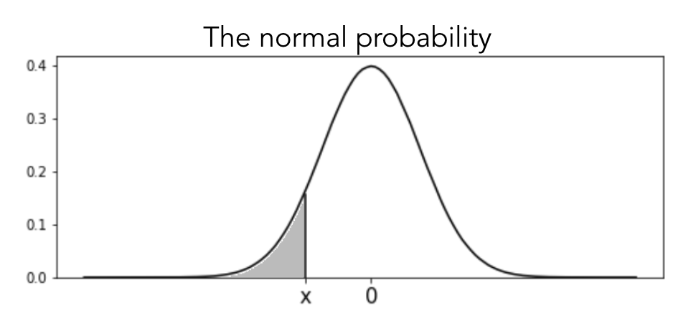
The normal table
Let the r.v. X strictly follow the standard normal distribution
Let r.v. X take a negative value x
This table gives the lower tail probabilities; P(X ≤ x)
Table Ref: Link

Slide 72
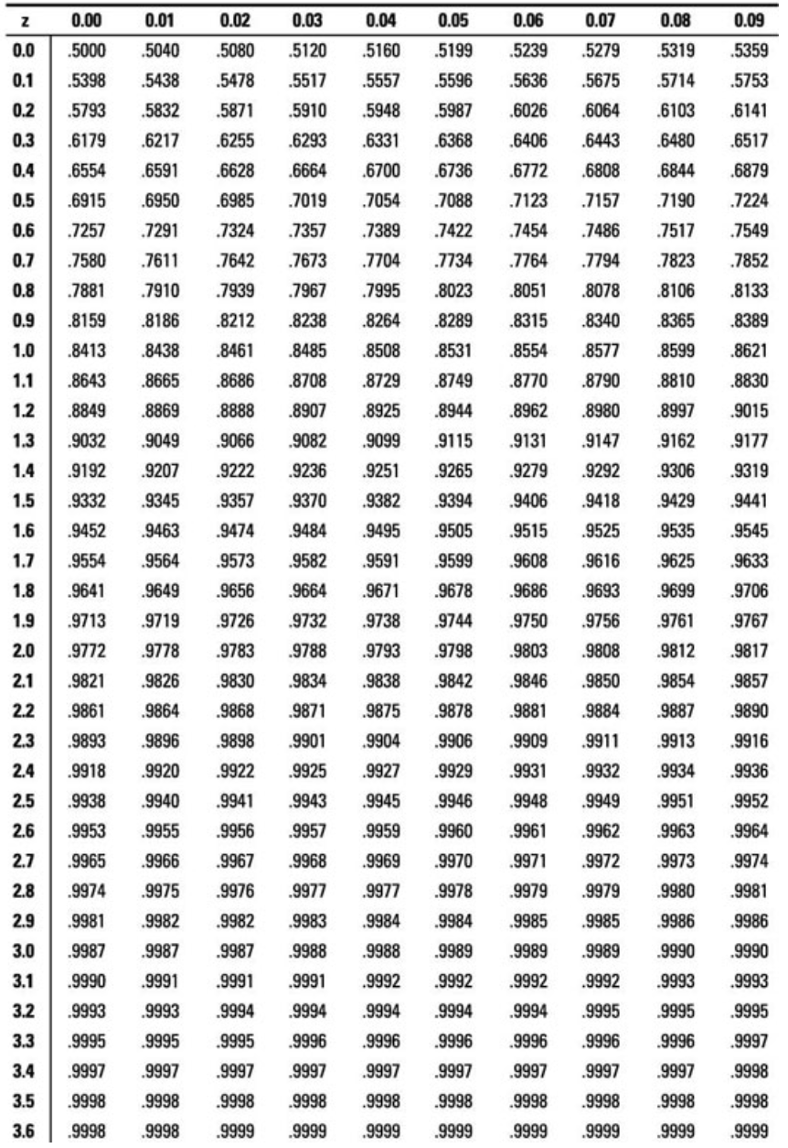
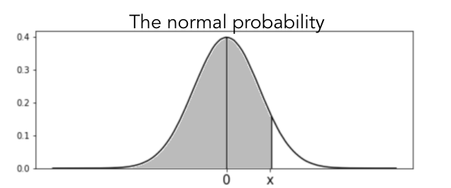
The normal table
Let the r.v. X strictly follow the standard normal distribution
Let r.v. X take a positive value x
This table gives the lower tail probabilities; P(X ≤ x)
Table Ref: Link

Slide 73
Normal distribution
Solution:
We know that for X ~ N(𝛍, σ²), if Z = (x - 𝛍)/σ then Z ~ N(0, 1) that is the standard normal distribution
X ~ N(𝛍 = 500, σ² = 100) thus Z = (x - 500)/√100 ~ N(0, 1)
The required probability is P(X > 513.5), now becomes

Slide 74
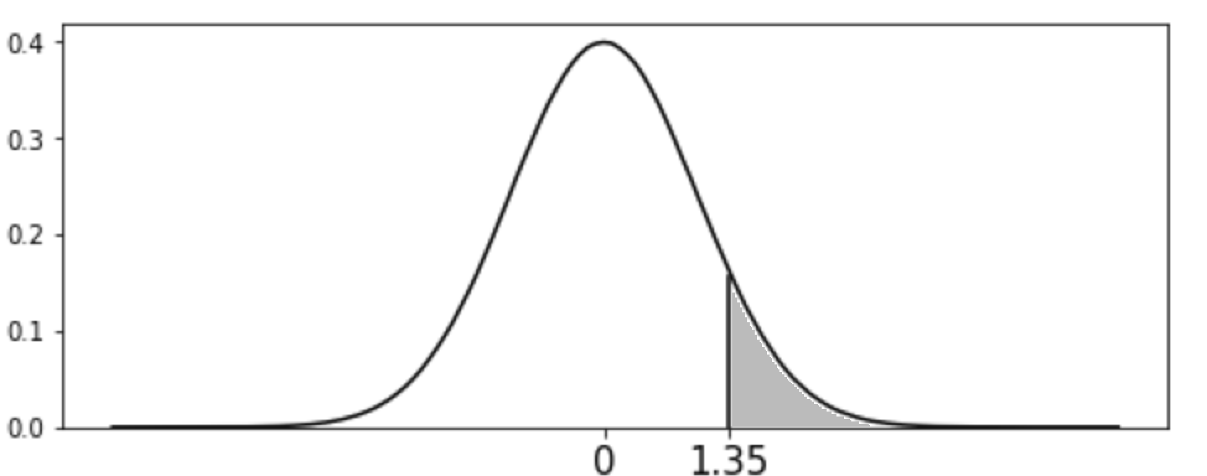
Normal distribution
Solution:
Thus the required probability now is P(Z > 1.35)
The shaded region represents the required probability
Now we refer to the normal table to the probability

Slide 75
Normal distribution
2
Solution:
The table gives P(Z ≤ 1.35).
Look horizontally in the row of 1.3
Consider the value corresponding column to 0.05
1

Slide 76
Normal distribution
Solution:
Since we get the lower tail probability as 0.9115
The required probability P(Z > 1.35) = 1 - P(Z ≤ 1.35)
= 1 - 0.9115
= 0.0885
The probability that the balance can be more than $513.5 is 0.0885

Slide 77
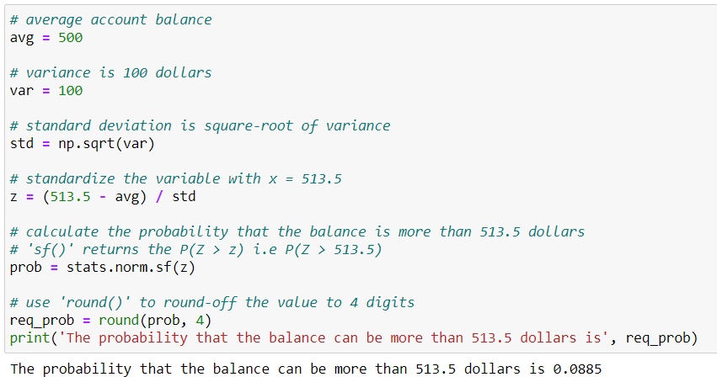
Normal distribution
Python solution:

Slide 78
The scipy.stats.norm.cdf() in python gives the lower tail probabilities

Slide 79
Summary
Continuous distributions: Uniform and normal
Continuous distribution is determined using probability density function (p.d.f.)
The value of pdf at a particular point is always zero
For a normal distribution, Mean = Median = Mode
Standard normal distribution has mean zero and variance one

Slide 80
Population and Sample

Slide 81

Population & Sample
Population is a collection of all the individuals or objects
Sample is a subset of the population which is a representative of the population
Sample
Population

Slide 82
Need to draw a sample
In some of the real case scenarios we may not be able to gather all the observations in the population
In such cases we can consider a sample which can be used to draw inferences about the population
Sampling can reduce the computational time and cost
In machine learning models, a sample obtained using an appropriate sampling strategy can provide accurate results with the less number of observations

Slide 83


Need to draw a sample
Suppose a company producing electric bulbs wants to know the average life of a bulb. If the details of all the bulbs are available, then this information is regarded as the population.
It would be challenging for the company to test each and every bulb produced. In such a scenario, the company would draw a sample from the produced bulbs to test.

Slide 84
Terminologies
Sampling unit: An individual and indivisible unit of the population eligible to be in the sample
Sampling frame: An exhaustive list of all members or elements of a population
Sampling: To consider a subset of the population
Sampling fraction (f): Ratio of sample size (n) to population size (N), i.e, f = n/N

Slide 85
Sampling techniques
Sampling
Probabilistic Sampling
Non-Probabilistic Sampling
Simple Random Sampling
Stratified Sampling
Systematic Sampling
Cluster Sampling

Slide 86
Simple random sampling (SRS)
Simplest and most common method
Sample is drawn unit by unit
Each unit has equal probability of being selected
Two ways of selecting units:
Without replacement: if the selected unit is not returned to the population
With replacement: if the selected unit is returned to the population

Slide 87
SRS without replacement
At any specific stage in the sampling, the probability of any of the remaining units is 1/N, where N is the total number of sample units
From N sample units, if a sample of size n is drawn, there are ^{N}C_{n} possible samples
The probability of selecting one of them is 1/^{N}C_{n}

Slide 88
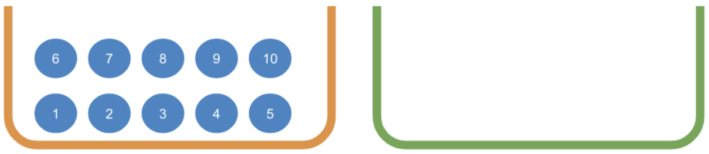
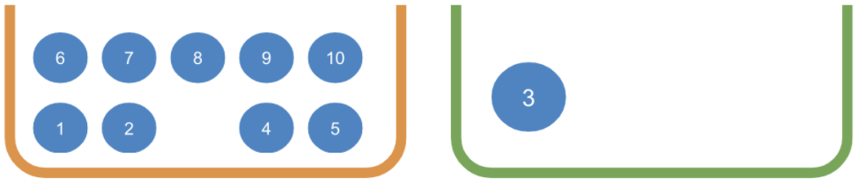

SRS without replacement
The unit selected to be in the sample is not returned to the population.

Slide 89
SRS without replacement - example
Drawing a sample from manufactured articles to know the proportion of defectives.
Manufactured articles
Sample to test for defective articles
1
3
4
8
11
5
15
2
6
7
9
10
12
13
14

Slide 90
SRS with replacement
The probability of selecting a specific unit at any given draw is always 1/N, where N is total number of sample units
From N sample units, if sample of size n is drawn, there are N^{n} possible samples
The probability of selecting one of them is 1/N^{n}
Example: You have 5 fruits and want to take a sample of 2. You can choose a fruit more than once.

Slide 91




SRS with replacement
The unit selected to be in the sample is returned to the population.

Slide 92
SRS with replacement - example
Generally used in simulation studies
A car insurance company wants to set the premium amount. The probabilities for major and minor accident are known to be 0.02% and 2% respectively (assume that an insuree can meet with an accident only once)
A SRS with replacement is conducted to simulate 1 million such scenarios

Slide 93
Simple random sample - python function
Python function | Description
random.choices() | draw sample with replacement
random.sample() | draw sample without replacement

Slide 94
Stratified sampling
Used when data is heterogeneous
Data is divided into homogeneous strata and a sample is drawn from them
Strata are subgroups of the population formed on the basis of some similarity in units
Stratified sampling is done to accommodate representation of every stratum into a sample

Slide 95




Stratified sampling
The heterogeneous population
The population is divided into homogeneous stratas
The sample represents every strata
The sample is heterogeneous

Slide 96


Stratified sampling - example
Population
An economist wants to study the socio-economic strata of the society
He divides the data into stratas as Below Poverty, Low, Middle, and High socio-economic groups
A sample is drawn from each of the strata
Sample

Slide 97

Systematic sampling
Sampling is done in a systematic manner
From a population of N = 36 if a sample of n = 6 is to be drawn, then data is arranged in k parts such that N = nk
A random number is chosen from 1 to 6 (say 4)
The data corresponding to this number is the systematic sample

Slide 98

Systematic sampling - example
Use when there are no patterns in the data
To test the quality of packaging, packets are to be selected from a box
Systematic sampling can be used such a scenario

Slide 99
Cluster sampling
Used when populations have small groups
These groups are called clusters
The entire cluster is considered to be a sampling unit
A cluster sample consists of these randomly selected clusters

Slide 100






Cluster sampling
Population
Sample

Slide 101

Cluster sampling - example
Widely used in market research
For study on taxes in the USA, the researcher will form clusters and select the clusters for study
The researcher can consider the present political states as the clusters and select a sample of required size
This reduces fieldwork costs, time required and much inconvenience

Slide 102
Stratified and cluster sampling
Stratified Sampling
Sample is taken from each stratum
Each strata is represented in the sample
Within strata variation is low and between stratum variation should be high
Cluster Sampling
The entire cluster is the sample
Every cluster may not be in the sample
Within cluster variation should be high and between cluster variation is low

Slide 103
Sampling variability
Let us draw four different samples from the data
The sample mean varies from sample to sample
This intuitive idea is called sampling variability
The sample mean is close to the population mean
Population Mean
15.125
Sample | Sample Mean
14.7, 15.1, 15.0, 15.6, 14.9, 15.4, 15.8, 15.1 | 15.20
15.8, 15.5, 15.3, 15.4, 15.8, 14.8, 14.6, 14.8 | 15.250
15.7, 15.6, 14.8, 14.8, 14.7,14.9, 15.6, 15.1 | 15.150
14.8, 15.1, 15.7, 14.6, 15.6, 15.4, 15.6, 15.0 | 15.225

Slide 104
A machine is used for packing grains in a sack. The weight of every bag is recorded as follows:
15.6 | 15.7 | 14.6 | 14.7 | 15.8 | 15.0 | 15.1 | 14.9
14.8 | 15.5 | 15.4 | 15.3 | 14.8 | 15.1 | 14.8 | 14.9
Draw at least the two samples and obtain their means. Compare this with the population mean.

Slide 105
Sampling | Pointer
Stratified

Slide 106
Summary
Sample is the subset of the population
Different sampling methods: SRS with replacement (SRSWR), SRS without replacement (SRSWOR), Stratified, Systematic, Cluster sampling
SRSWR method can be used if one wish to select the sample observation more than once
Stratified sampling can be used when data is heterogeneous
Cluster sampling can be used when the data consists of several groups

Slide 107
Resampling

Slide 108
Resampling
Resampling is a technique in which we draw a sample from the available sample
The resampling techniques are:
Bootstrap resampling
Jackknife resampling

Slide 109



Bootstrap resample
Bootstrap resample is a simple random sample with replacement drawn from a sample
Bootstrap Resamples
Population
Sample

Slide 110

Jackknife resample
Jackknife resample is a method in which one deletes m observations from the original sample
Jackknife Resamples (m = 2)
Population
Sample

Slide 111
Sampling Distributions

Slide 112
Parameter and Statistic
Parameter:
The population quantities are termed as a parameter
In inferential statistics, sample is used to estimate the population parameters
Example: Population mean
Statistic:
Statistical measure computed from sample observations
Also known as an estimator
Example: Sample mean

Slide 113

Parameter and Statistic
The statistical notations for population parameters and sample statistics
 | Population Parameter | Sample Statistic
Mean | µ | x̄
Variance | σ² | s²
Standard Deviation | σ | s
Proportion | p

Slide 114
Sampling distribution
A total of ^{N}C_{n} (= k say) samples can be drawn from a population of size N and sample size n
Obtain the mean and variance of each of these samples
Population
S₁
S₂
S₃
S_{i}
S_{k}
k samples

Slide 115
Sampling distribution of sample mean
The set of sample means x̄₁, x̄₂,..., x̄_{k} are the observations for sampling distribution of sample mean
These sample means follow the normal distribution
Also, the mean of sample means is the population mean μ_{x̄} = μ
Sample No | Sample Mean
1 | x̄₁
2 | x̄₂
3 | x̄₃
፧ | ፧
k | x̄_{k}

Slide 116

Sampling distribution of sample mean
The mean of sampling distribution of sample mean is μ_{x̄}
The standard deviation of sampling distribution is σ/√n

Slide 117

Central limit theorem
The central limit states that for random samples of large size n (usually n > 30) taken from a single population with mean µ and standard deviation σ, the sampling distribution of mean follows a normal distribution with mean µ and standard deviation σ/√n.

Slide 118

Central limit theorem

Slide 119

Proportion
Computed for a categorical variable
Proportion (p) is the ratio of the number of observations of the desired category to the total number of observations
It is given by
where x is the number of observations of the desired category and n is the total number of observations

Slide 120
Sample proportion
The sample proportion is an estimate of the population proportion
Like the sampling distribution of mean is obtained from samples, the sampling distribution for proportions can also be obtained
The set of sample proportions are the observations for the sampling distribution of the sample proportion
Sample No | Sample Proportion
1 | ₁
2 | ₂
3 | ₃
፧ | ፧
k | _{k}

Slide 121
Sampling distribution of sample proportion
For a SRS from a large population, X follows Binomial distribution representing the number of observations of desired category in the sample
Let the sample size be n, which is a constant
For Y = X/n, P(Y = y) = P(X/n = x/n) is same as P(X=x). i.e. P(x/n) = P(x)
We have E( ) = p Where is the sample proportion and p is the population proportion
For np ≥ 5 and n(1 - p) ≥ 5, follows normal distribution

Slide 122
Summary
The parameter describes the population and the statistic describes the sample
There are different notations for population parameter and sample statistic
Sampling distribution is the distribution associated with sample statistic
Sampling distribution of the sample mean follows normal distribution with mean μ_{x̄} and standard deviation σ/√n
Proportion is calculated for the categorical variable

Slide 123
Thank You

Slide 124
Appendix

Slide 125

Binomial distribution (A.1)
Steve has invested in a scheme. The following tree shows all the possibilities of how his investments may vary year to year over a period of three years

Slide 126
Binomial distribution
Let X be the event of a change in the initial invested amount
There is a profit with probability p, naturally the loss incurred will have the probability 1-p = q (say)
Let the probability of profit be 0.4 i.e. P( X = P) = p = 0.4
Let the probability of loss be 0.6 i.e. P( X = L) = 1 - p = 1- 0.4 = 0.6

Slide 127

Binomial distribution
The probability of each of the possible scenarios is calculated as follows:

Slide 128
Binomial distribution
We can easily tabulate these probabilities.
Number of Profits | Probability
0 | 0.216
1 | 0.144
2 | 0.096
3 | 0.064

Slide 129

Binomial distribution
It is based on the Bernoulli distribution
A discrete random variable (X) taking values 0,1,2,...,n follows a binomial distribution if the p.m.f. of X is given as:
X follows binomial distribution with parameters n and p, i.e X ~ Binomial(n,p)
p is the probability of success, q is the probability of failure and n is the number of times the experiment is conducted

Slide 130
Binomial distribution
Recall Steve’s example, multiply each probability with ^{n}C_{x}
Number of Profits (x) | Probability | ³C_{x} | P(x) = ³C_{x} Probability
0 | 0.216 | ³C₀ = 1 | 0.216
1 | 0.144 | ³C₁ = 3 | 0.432
2 | 0.096 | ³C₂ = 3 | 0.288
3 | 0.064 | ³C₃ = 1 | 0.064

Slide 131

Binomial distribution
The probability of the Binomial(3, 0.4)
Number of Profits (x) | P(x) = ³C_{x} Probability
0 | 0.216
1 | 0.432
2 | 0.288
3 | 0.064

Slide 132
If n independent random variables are Bernoulli distributed, then the sum of these random variables follows a Binomial distribution

Slide 133


Binomial distribution
The mean and the variance of the distribution is given as:
For our example, if n = 10, p = ⅔ and q = ⅓ . Then, E(X) = 20/3 and V(X) = 20/9

Slide 134
Binomial distribution - python function
Python function | Description
scipy.stats.binomial.pmf() | returns the pmf of discrete binomial distribution
scipy.stats.binomial.cdf() | returns the cdf of discrete binomial distribution
scipy.stats.binomial.sf() | calculates the value of survival function (1 - cdf)

Slide 135
Binomial distribution
Question:
In a shooting academy, data was collected on the precision shooting of a student. From 15 shots fired 11 were on target. Considering the same student, what is the probability that out of 50 shots fired, exactly 35 will hit the target?

Slide 136
Binomial distribution
Solution:
Let X denote the shot fired hits the target
The probability of success, i.e. is hitting the target is 11/15
Thus, p = 0.733
To find: the probability that out of 50 shots fired, 35 will hit the target
Here, n = 50
We have X~Binomial(50, 0.733)

Slide 137
Binomial distribution
Solution:
The required probability is P(X = 35)
P(X = x) = ^{n}C_{x} p^{x} (1-p)^{n-x}
P(X = 35) = ⁵⁰C₃₅ (0.733)³⁵ (1-0.733)⁵⁰⁻³⁵
= ⁵⁰C₃₅ (0.733)³⁵ (0.267)¹⁵
= 0.107
Thus, the probability that out of 50 shots fired, exactly 35 will hit the target is 0.107

Slide 138

Binomial distribution
Python solution:

Slide 139

Uniform distribution (continuous) (A.2)
The continuous uniform distribution represents a situation where all outcomes in a range between a minimum and maximum value are equally likely
The p.d.f. of the uniform distribution is,
The values taken by X are equiprobable

Slide 140





Uniform distribution (continuous)
The mean and the variance of the distribution is given as:
For example, if a = 2 and b = 6 Thus, E(X) = 4 and V(X) = 4/3

Slide 141
Uniform distribution - python function
Python function | Description
scipy.stats.uniform.pmf() | returns the pmf of discrete uniform distribution
scipy.stats.uniform.cdf() | returns the cdf of discrete uniform distribution
scipy.stats.uniform.sf() | calculates the value of survival function (1 - cdf)

Slide 142
Uniform distribution (continuous)
Question:
A gas supplying company has a pipe of 200 kms from the its supplying centre to the city. What is the probability that the pipe leaks in the middle 100 kms. (Assume that the chance of pipe leakage is equal on the entire route)

Slide 143
Uniform distribution (continuous)
Solution:
Let X: the event that the pipe leaks at x kms
It follows an uniform distribution over the interval [0,200]
To find: the probability of pipe leakage in the middle 100 kms., i.e. between 50 to 150 kms
The required probability is P( 50 ≤ x ≤ 150)

Slide 144




Uniform distribution (continuous)
Solution:
Thus, the probability pipe leaks in the middle 100 kms is 0.5

Slide 145

Uniform distribution (continuous)
Python solution:

Slide 146
Relation of expectation and variance (A.3)
V(X) = ∑ (x - µ)². f(x)
= ∑ (x² - 2µ.x + µ²). f(x)
= ∑ (x² - 2µ.x + µ²). f(x)
= ∑ x² . f(x) - ∑ 2µ. x . f(x) + ∑ µ². f(x)
= ∑ x² . f(x) - 2µ ∑ x . f(x) + ∑ µ². f(x)
= E(X²) - 2 E(X) . E(X) + [E(X)]²
= E(X²) - [E(X)]²

